Slide 1
King County Housing
Final project presentation
By Yin Jiang, Chongfan Bao
Notes:
Good evening, everyone. Today, we are presenting the work we completed for our final project.
Our team has selected a housing dataset from Kaggle.
The dataset contains one year house sales record of King County at Washington State.
The objective of the project to find some helpful information in supporting buyers and developers to make buying decisions.

Slide 2
Dataset Overview
Notes:
This chart provides an overview of the dataset. The dataset has 21,613 records, 20 attributes, three data types. There is no missing value.

Slide 3
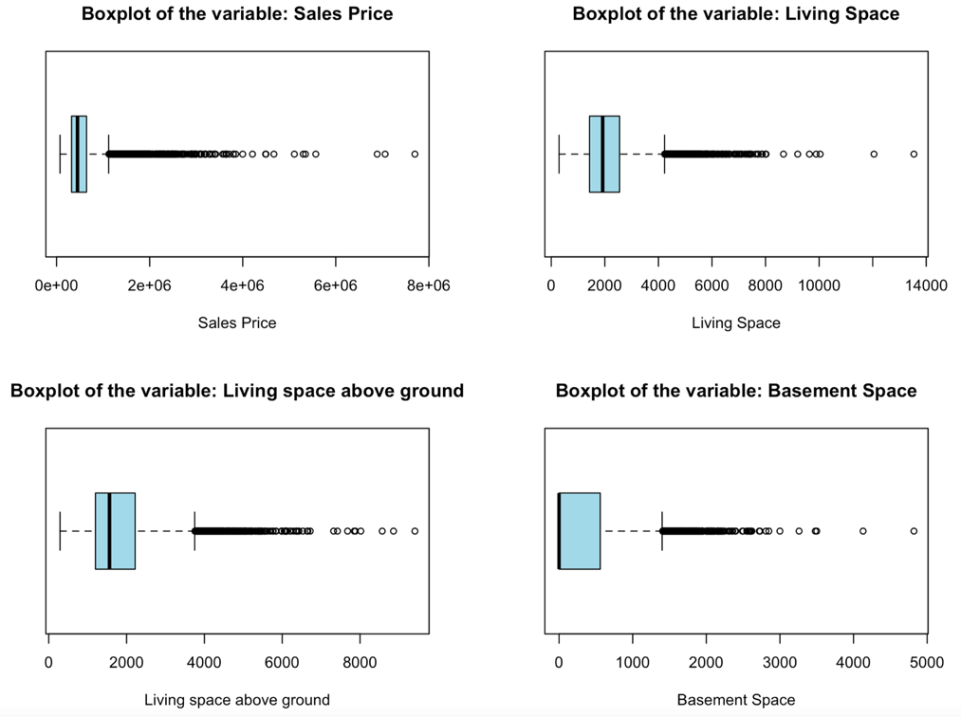
Data preprocessing
New columns
Duplication checking
Outlier checking
Notes:
We clean the dataset before mining. First, we found and removed 177 duplicated records using the unique identifier “sales ID”.
Second, we convert the date’s data type from object to datetime format.
In addition, we created a new attribute called “Age of the house”.
Next, we check if there is any outliers in the dataset. We use boxplot and scatter plot to observe the data.
In this boxplot, we found that “Sales price” has a lot datapoints outside the range , however, when we look at other attributes related to living spaces. We notice the “Sales price” correspondent to these attributes. In this case, these price outliers are legitimate and shall be kept.

Slide 4
Data preprocessing
Outlier checking
Record before value replacement
Record after value replacement
Notes:
Through the bedroom scatter plot, we notice there is one house comes with 33 bedrooms. So we extract this single record and checked further, we concluded that it is impossible for a house with1620 sqt living space to have 33 bedrooms, this could be a human typo. Hence, we change the number of rooms to 3.

Slide 5
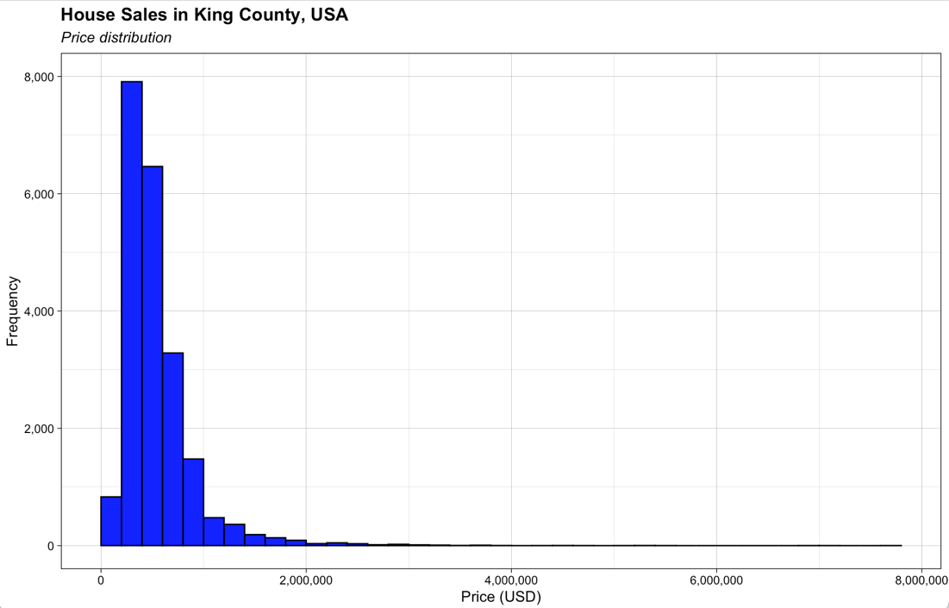
EDA – Price distribution
Notes:
This chart shows the price distribution of the entire dataset, we learned that most of houses were sold prices 2 million, most of house deals were closed between 250 thousands to 850 thousands. We still find that there are few abnormal high house price.

Slide 6
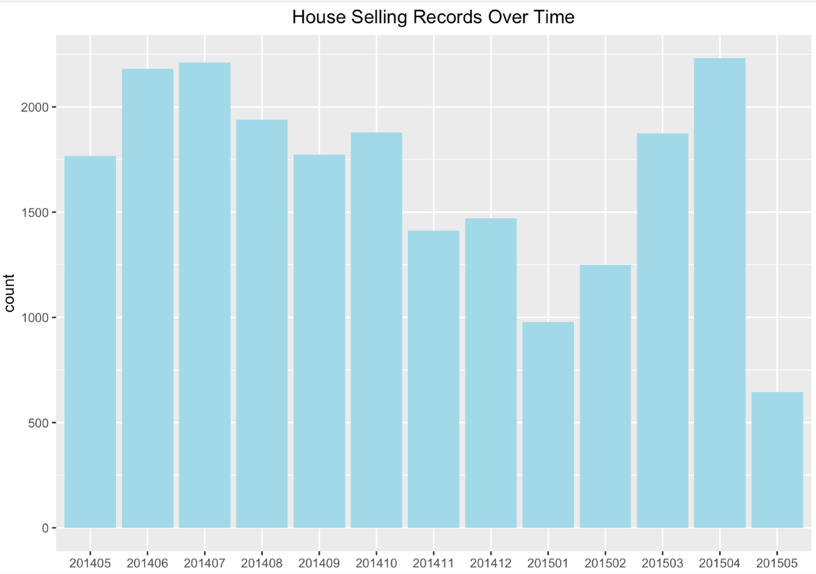
EDA – Sales record by month
Notes:
This picture shows a whole year house sales records from May 2014 to May 2015.
Apr 2015 has the highest sales record.
From July 2014 to January 2015, the selling is slowly decreasing. Based on this image, the top three best selling times are in April, June and July. If we get more years of data, we may be able to determine the sales pattern.

Slide 7
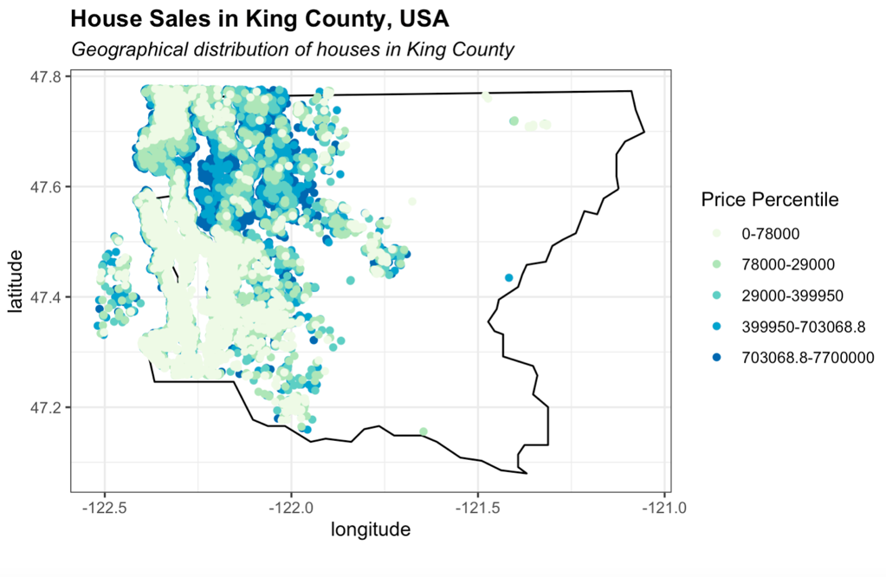
Waterfront impact price?
Notes:
We visualized the sales record in map, and notice that most of the houses sold are locating beyond longitude -121.5 and above latitude 47.5. We also see that most of these house prices are between 0 and 78 thousands dollars that they locate the left side of the map. In addition, according to pie chart plot, we know about 99% of sold houses have waterfront, which indicates that this factor may not impact the house price much.

Slide 8
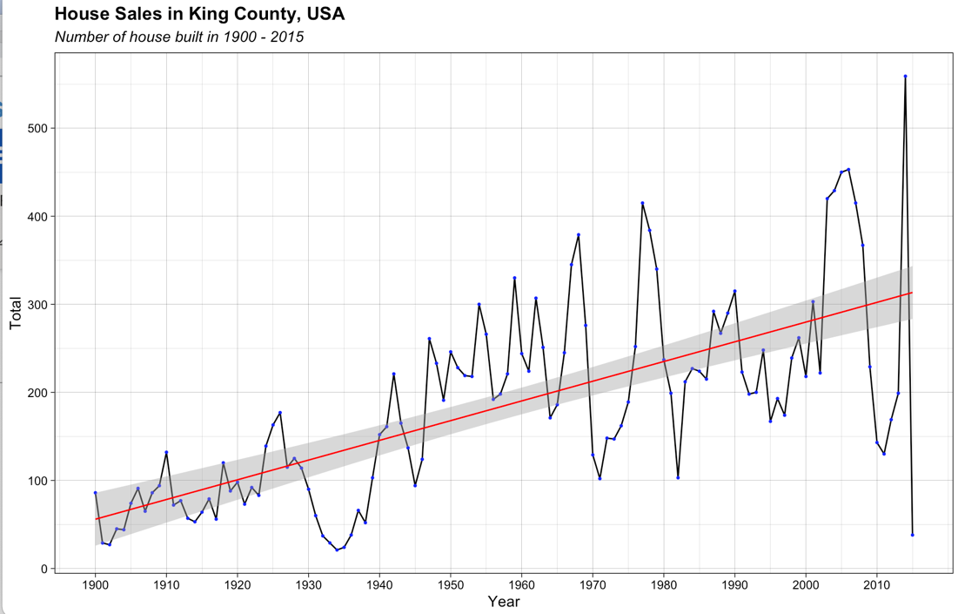
EDA - House building Trend since 1900
Notes:
We would like to find out whether the house market at King County is stable. This diagram shows the house building trend since 19 hundred, from this image, we learned the numbers of built houses reached a peak almost every ten years, which indicates that the house demand at King County is quite stable in long term.

Slide 9
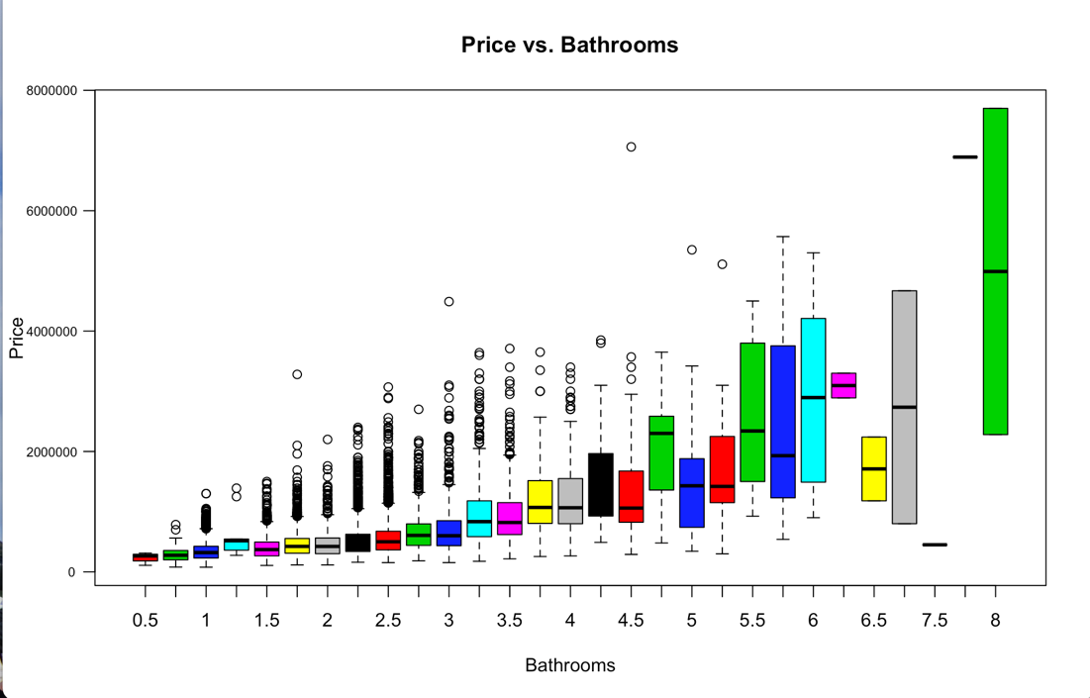
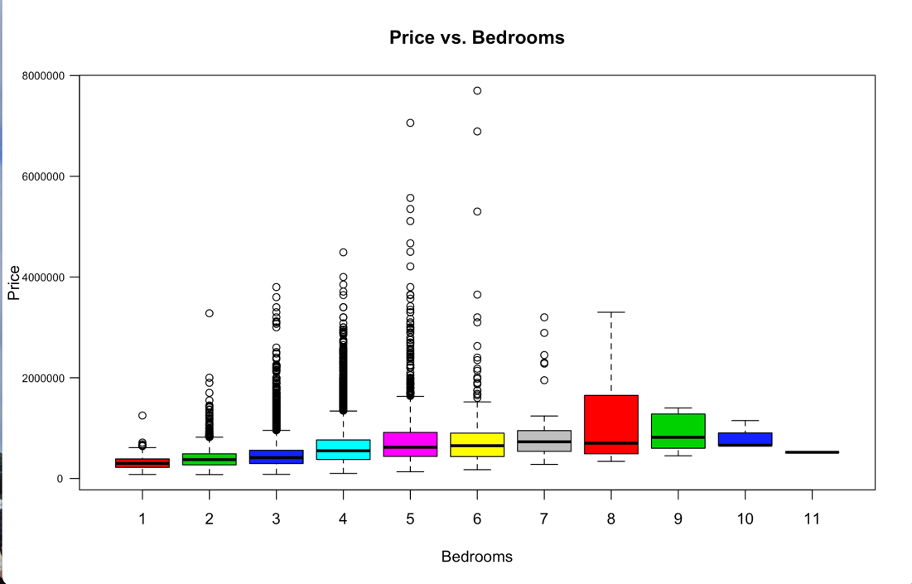
EDA – Rooms vs Price?
Notes:
Based on this figure, house values increase when the number of bedrooms and bathrooms increasing, which makes sense as the more rooms mean more sqaure footages. Furthermore, we found that when the number of bedrooms is greater or equal to 8, there is no abnormal high prices. After checking this, we found this is because the data sample over 8 bedrooms are too small, only 24 records. So, we think that the analysis may be bias.

Slide 10
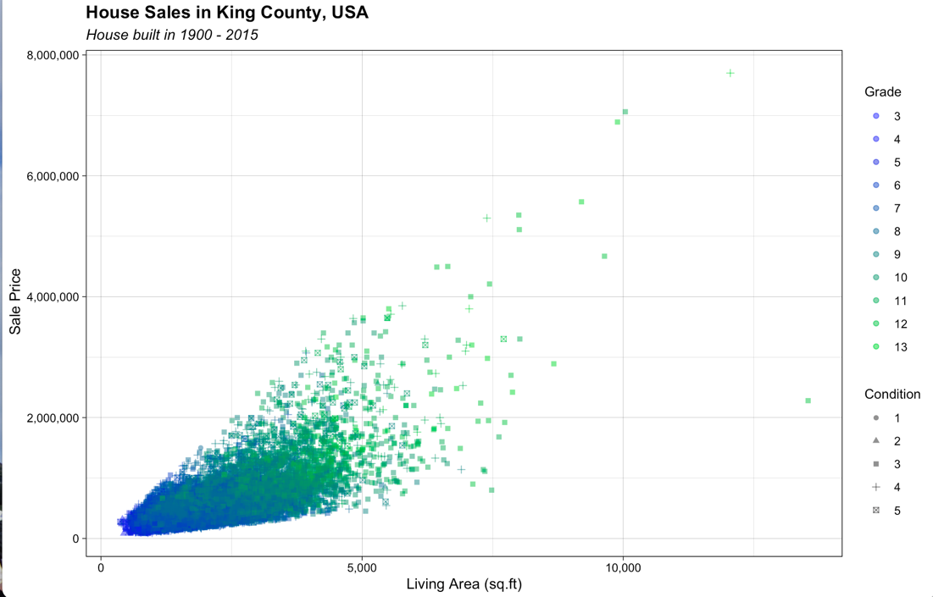
Price vs Living Space, Grade rating & Condition rating
Notes:
From this image, we find that the better the house condition, the higher the grade and the price. In addition, when the live area is over 5,000 square footages, the condition score is greater or equal to 3 and the grade is over 10.

Slide 11
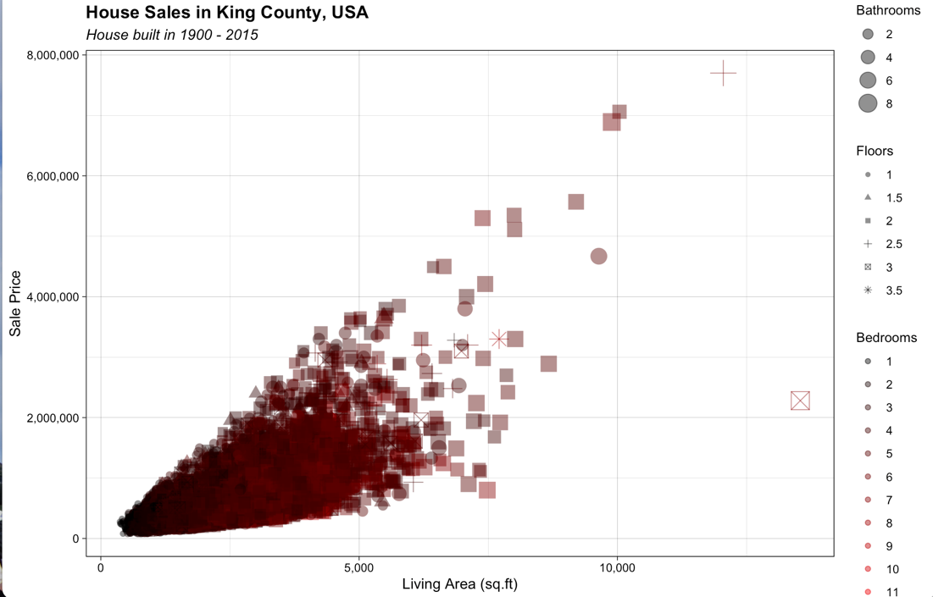
Price vs Living Space, Bathrooms, Floors and Bedrooms
Notes:
The diagram shows the price with relation with living space under the number of bathrooms, bedrooms and floors circumstance. We learned that the popular houses are the living space beyond 5,000 square footages and have at least 2 floors or 8 rooms.

Slide 12
Top 5 popular locations
Notes:
With an overall understanding of the dataset. Next, we would like to find out what kind of houses are popular at popular locations at King County. This chart shows the sales record of the top 5 popular location of King Count. We noticed at least 550 houses sold in these five locations in that year. Next, we would like to find out what kind of houses are in demand at popular location.

Slide 13
Factors vs price at No1 popular location
Notes:
We extract the subset of data using the top 1 location's zip code 98103. Through scatter plot, we learned that most of the sold houses have at least 2 floors with condition graded above 3. When the land size is larger than 4000 sqt, the price can go beyond 1 million dollars. However, the houses with less than 5000 sqt are more popular. From the age of the houses, we can tell the ones less than 20 years old or more than 80 years old are more popular.

Slide 14
Linear regression
Notes:
With some learning of the dataset. We moved on to explore models. We have explored three models, linear regression, random Forrest and K-means.
We chose linear regression mode to predict price, because the dataset is a time series, and the target variable “price” is a continuous dependent variable.
The regression score is shown in the top left corner, which indicates the model performance score is 71.72. The scatter plot shows that most of data points align around regression line. The last screenshot shows the coefficient of the attributes, the ones above positive 5 are living space, grade, year built and lat.

Slide 15
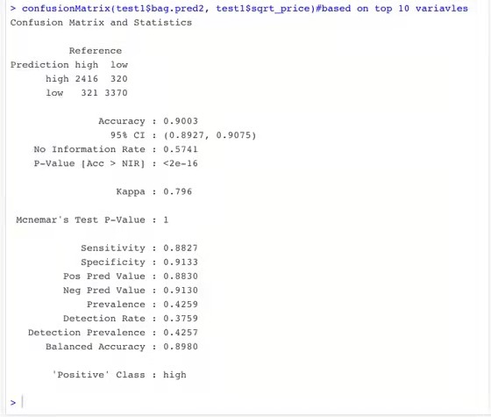
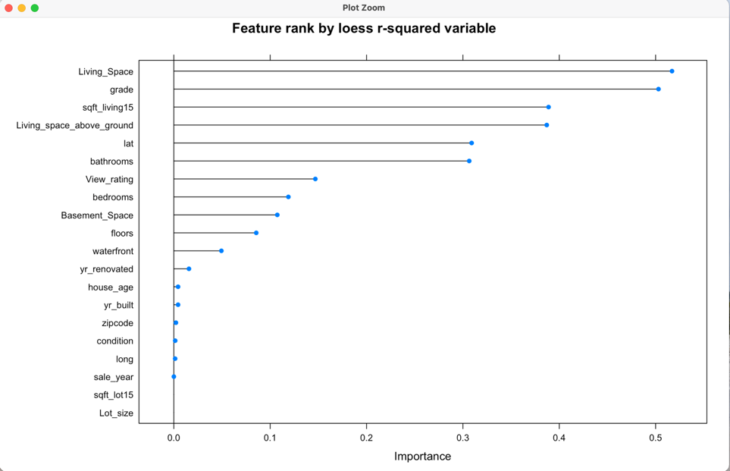
Random Forest
Notes:
Random forest is chosen here, because it has high performance in terms of predication result and is flexible to both classification and regression problems. To ensure optimize result, when building random forest, we tried to identify the important features. The image on the left shows the result of the feature importance, we see that the "living space" has a greatest impact on the price. The image on the right shows the result of the model using the top ten features. We can see that this model's accuracy is 90%.

Slide 16
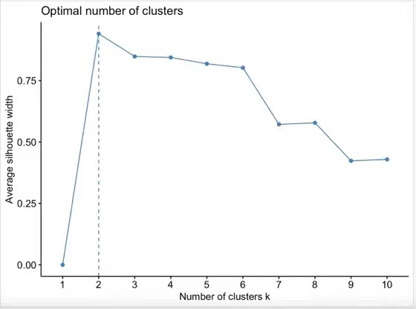
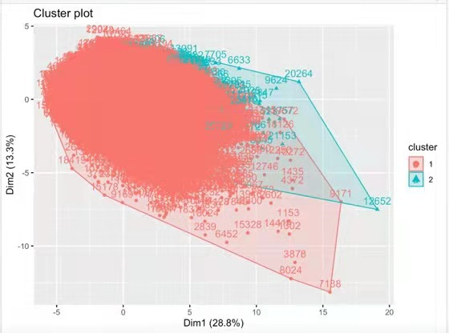
K-means
Notes:
K-means model scale to large data into new data samples, we can read data easily. To implement K-means, the first step is to find an optimal number of clustering. Based on the Silhouette algorithm, we find out the best optimal K value is 2 showed in the left side. However, when we draw the dataset, We noticed there are huge overlapped between two clusters. Overlapped clusters indicate that there are outliers in the dataset. In this case, it indicates that we maybe need to clean our data further or the overlap may be inherent to the processes that produced the data. We will conduct further research in the future.

Slide 17
Recommendation
Notes:
I am wrapping up our presentation with our recommendations.
When considering buying houses at King County as investment properties, the buyers shall consider holding the house for at least 9 years and sell the houses when the market is in demand. For the developers considering houses at the popular locations at King County, they shall consider buying the houses ranged between $200,000 to $400,000 with 2.5 floors, age between 20 to 60 years with low grade and condition scores. Because these types of houses are less competitive in the market, so they can do some upgrade work to improve the house condition and grading scores and sell it for profit.
For companies, who would like to build models using this dataset. They shall consider collect more data cross several years, and also more data attributes such as walkable score, etc
And then clean the dataset further to remove hidden outliers, and explore feature engineering methods to optimize the models

